Slide 1
YAAS: Yet Another Animation System
by William Hipschman
with Rebecca Crabb and Prasun Dewan

Slide 2
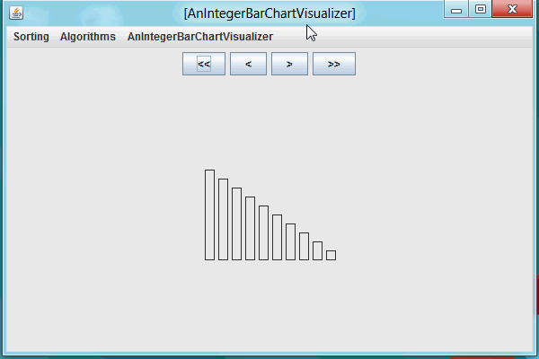
Animation
Lets viewer see each of a series of updates to a graphical view of a data structure

Slide 3
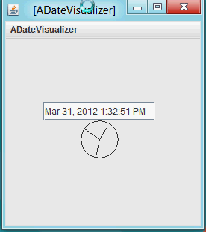
Animation Hurdles
How do we iterate through animation frames?
What data can be animated?
How do we represent data?
How do we display graphics?

Slide 4
Need for Automation
Some of the steps should be automated so the programmer doesn’t need to do them.

Slide 5
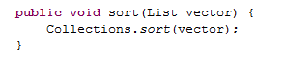
Full Automation: Holy Grail
All steps are automated

Slide 6
What To Automate?
Single-Step Undo/redo?
Graphics?
Import/Export?
Psuedo code?
Actual code?

Slide 7
Flexibility of Automation?
Data type
System-defined
Programmer-defined
Graphics type
System-defined
Programmer-defined

Slide 8
Single Step Execute/Undo-Redo

Slide 9
How Can We Build a Clock?

Slide 10
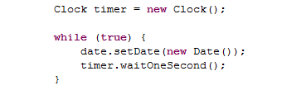
Updating a Clock

Slide 11
How can we Delay Execution?
Observable Data
List of Shapes
Observing Side
Observable Side
Delegated Command History

Slide 12
Command Objects
Problem: Previous systems store complete histories or many frames
Solution: Use command objects to use space efficiently when making copies

Slide 13
Undo/Redo with Single-Step/Batch Execution
Problem: User may wish to not only undo and redo but also single-step or run through all program commands.
Solution: Create a new architecture, based on a bounded buffer of command objects and a system-generated consuming thread.

Slide 14
Solution: Use Producer Consumer Synchronization
Observable Data (Producer)
List of Shapes (View)
Observing Side (Consumer)
Observable Side (Model)
Delegated Command History

Slide 15

Undoable-Redoable, Single-Step and Batch Animation

Slide 16
Patterns And User-Defined Data Types

Slide 17
How Can We Make Our Approach More General?
The programmer shouldn’t need to write command objects
The programmer shouldn’t have to create a copy
The programmer shouldn’t have to worry about managing listeners

Slide 18
Require more information from the programmer
Programming conventions imply undo/redo semantics
Notes:
Programming patterns, not design patterns

Slide 19
Programming Patterns
Bean
Set undoes Set
Observer
Update undoes Update
List
Remove undoes Insert
Set undoes Set
Swap undoes Swap

Slide 20
Reducing the Problem
We can fire events instead of command objects

Slide 21
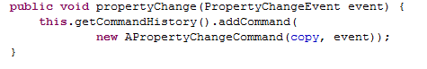
Transforming Events into Commands

Slide 22
Tradeoffs
Pros | Cons
Teaches common patterns | Programmer must conform to pattern
Programmer writes less code | Difficult to debug
Designing custom data structures is possible | Designing custom data structures can be difficult

Slide 23
Display Generation

Slide 24
Support for Shapes
Most systems have predefined shapes that they support

Slide 25
We Support Common Shape Patterns
public interface Point {
public int getX();
public int getY();
public double getAngle();
public double getRadius();
}

Slide 26
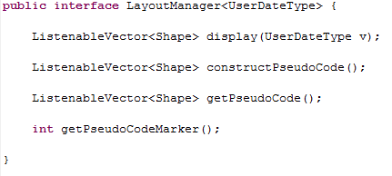
We Need to End up with a list of shapes

Slide 27
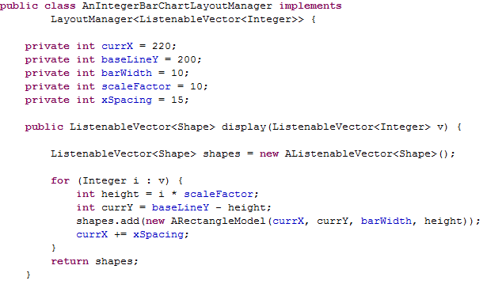
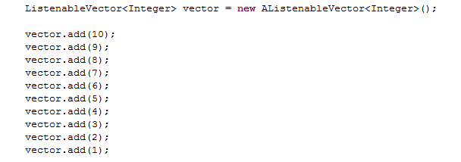
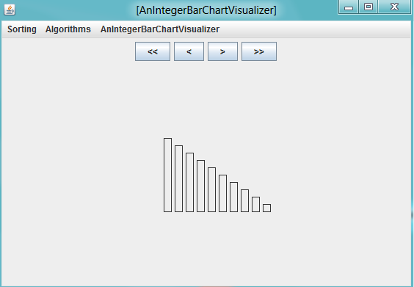

Slide 28
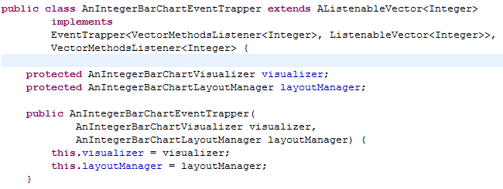
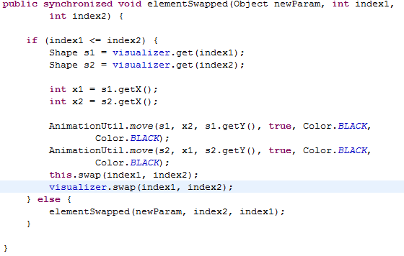

Slide 29
Animation for Previous Trapper
Notes:
That was the trapper for this animation we saw earlier.

Slide 30
How Are Events Processed?
Other systems require algorithms to be annotated to fire events.
If the programmer changes algorithms, they change events.
We associate events with data structures.
Events are shared by multiple algorithms.
Different algorithms can share complete code

Slide 31
Automatic Animation
Notes:
Both these animations use the same code, except for the algorithm run
There is a fixed cost for new data types
Buffer
LayoutManager
Trapper
Once those have been written, any series of operations on that data can be animated with no extra work

Slide 32
Pseudo Code Support

Slide 33
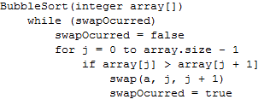
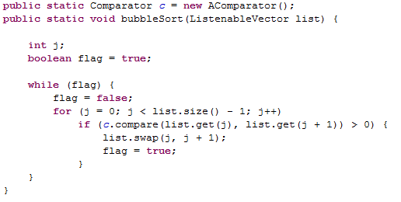
Pseudo Code vs. Actual Code

Slide 34
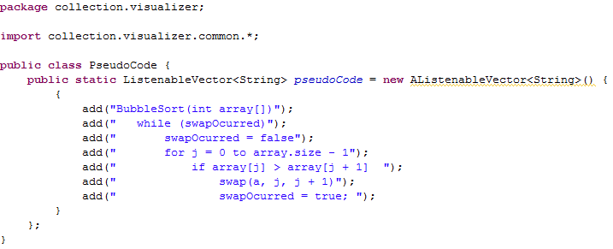
Run-Time Pseudo Code Class
Notes:
The programmer can deal with a vector instead of a file

Slide 35
We Can’t Intuit How Pseudo Code Should Be Mapped To Command Execution
More lines of pseudo code will be ‘executed’ than commands

Slide 36
Pseudo Code vs. Actual Code

Slide 37
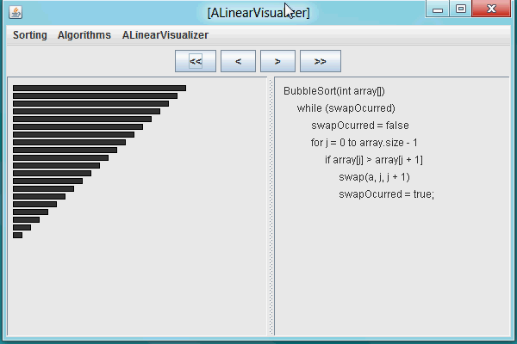
Pseudo Code Example

Slide 38
Conclusion

Slide 39
Modularization
Object Editor
Other Toolkit
Pseudo Code
No Pseudo Code
Existing Animation
Custom Animation
Bean
List
Observer
User/Defined
Pattern
Undo/Redo Engine

Slide 40
Framework Evaluation Dimensions
 | YAAS | TANGO | Jhave | ANIMAL | LEONARDO
Undo/Redo | Commands | API | Yes | Yes | CPU
User-Defined Data | Patterns | Annotations | No | No | Yes
Atomic Shapes | System/ Patterns | System | System | System | System
Shape Compositions | Yes | Yes | Yes | Yes | Yes
Import/Export | No | Yes | Yes | Yes | No
Pseudo Code | Yes | Yes | Yes | Yes | Yes
Actual Code | No | No | No | No | Yes
Time Efficient | Yes | Yes | Yes | Yes | No
Space Efficient | Yes | No | No | Yes | Yes
Fully Automatic Animation | Mostly | No | No | No | No
Notes:
This is a framework; we provide classes to simplify list, observer, and bean patterns, as well as factories for implementing additional patterns.
Add real code
Time efficiency or no
Space efficiency or no

Slide 41
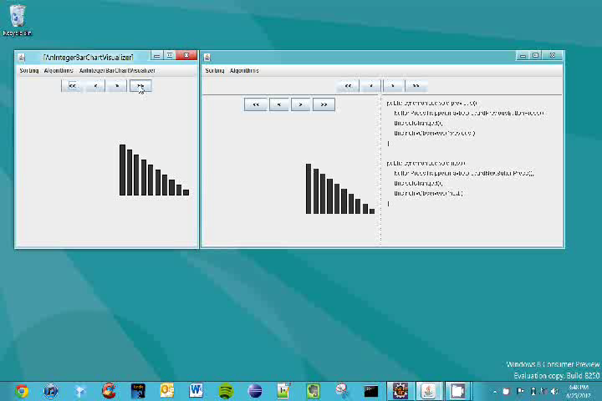
Animating YAAS

